Slide 1
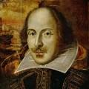
Romeo and Juliet

